Slide 1
Cornerstone City Church Peninsula Plus Community Hoo Are Ya 04-06-2023

Slide 2
House Of The Lord
CCLI Song # 7168995
© 2020 Phil Wickham MusicSimply Global SongsBe Essential SongsCashagamble Jet Music
For use solely with the SongSelect® Terms of Use. All rights reserved. www.ccli.com
Note: Reproduction of this sheet music requires a CCLI Music Reproduction Licence. Please report all copies.
CCLI Licence No. 33265

Slide 3
1/5
We worship the God who was
We worship the God who is
We worship the God who evermore will be
He opened the prison doors
He parted the raging sea
My God He holds the victory yeah

Slide 4
2/5
There’s joy in the house of the Lord
There’s joy in the house of the Lord today
And we won’t be quiet
We shout out Your praise

Slide 5
3/5
There’s joy in the house of the Lord
Our God is surely in this place
And we won’t be quiet
We shout out Your praise

Slide 6
4/5
We sing to the God who heals
We sing to the God who saves
We sing to the God who always makes a way
'Cause He hung up on that cross
Then He rose up from that grave
My God’s still rolling stones away

Slide 7
5/5
We were the beggars
Now we’re royalty
We were the prisoners
Now we’re running free
We are forgiven accepted
Redeemed by His grace
Let the house of the Lord sing praise

Slide 8
Way Maker CCLI Song # 7115744
Osinachi Kalu Okoro Egbu
© 2016 Integrity Music Europe (Admin. by Integrity Music)
For use solely with the SongSelect® Terms of Use. All rights reserved. www.ccli.com
CCLI Licence No. 33265

Slide 9
1/4
You are here moving in our midst I worship You I worship You You are here working in this place I worship You I worship You
(You are) Way Maker Miracle Worker Promise Keeper Light in the darkness my God that is who You are

Slide 10
2/4
You are here touching ev'ry heart I worship You I worship You You are here healing ev'ry heart I worship You I worship You
(You are) Way Maker Miracle Worker Promise Keeper Light in the darkness my God that is who You are

Slide 11
You are here turning lives around I worship You I worship You You are here mending ev'ry heart I worship You yeah I worship You Lord
(You are) Way Maker Miracle Worker Promise Keeper Light in the darkness my God that is who You are
3/4

Slide 12
That is who You are x4
Even when I don't see it You're working Even when I don't feel it You're working You never stop You never stop working x2
4/4

Slide 13
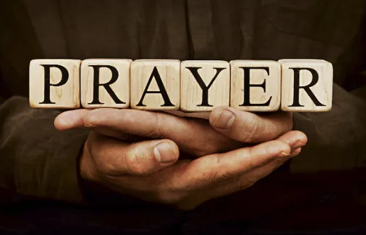

Slide 14
Goodness Of God
CCLI Song # 7117726
Ben Fielding | Brian Johnson | Ed Cash | Jason Ingram | Jenn Johnson
© 2018 Capitol CMG Paragon (Admin. by Capitol CMG Publishing)
Fellow Ships Music (Admin. by Essential Music Publishing LLC)
So Essential Tunes (Admin. by Essential Music Publishing LLC)
SHOUT! Music Publishing Australia (Admin. by SHOUT! Music Publishing UK)
Bethel Music Publishing (Admin. by Song Solutions)
For use solely with the SongSelect® Terms of Use. All rights reserved. www.ccli.com
CCLI Licence No. 33265

Slide 15
1/4
I love You Lord
Oh Your mercy never fails me
All my days
I've been held in Your hands
From the moment that I wake up
Until I lay my head
I will sing of the goodness of God

Slide 16
2/4
All my life You have been faithful
All my life You have been so so good
With every breath that I am able
I will sing of the goodness of God

Slide 17
3/4
I love Your voice
You have led me through the fire
In darkest night
You are close like no other
I've known You as a father
I've known You as a friend
I have lived in the goodness of God

Slide 18
4/4
Your goodness is running after
It’s running after me
Your goodness is running after
It’s running after me
With my life laid down
I’m surrendered now
I give You everything
Your goodness is running after
It's running after me

Slide 20
Holy Forever
CCLI Song # 7201044
Brian Johnson | Chris Tomlin | Jason Ingram | Jenn Johnson | Phil Wickham
© Phil Wickham Music (Admin. by / Small Stone Media BV, Holland (Admin. in the UK/Eire by Song Solutions www.songsolutions.org))
Simply Global Songs (Admin. by / Small Stone Media BV, Holland (Admin. in the UK/Eire by Song Solutions www.songsolutions.org))
Capitol CMG Paragon (Admin. by Capitol CMG Publishing)
S. D. G. Publishing (Admin. by Capitol CMG Publishing)
Be Essential Songs (Admin. by Essential Music Publishing LLC)
My Magnolia Music (Admin. by Essential Music Publishing LLC)
Bethel Music Publishing (Admin. by Song Solutions)
Brian and Jenn Publishing (Admin. by Song Solutions)
For use solely with the SongSelect® Terms of Use. All rights reserved. www.ccli.com
CCLI Licence No. 33265

Slide 21
1/10
A thousand generations falling down in worship
To sing the song of ages to the Lamb
And all who've gone before us
And all who will believe
Will sing the song of ages to the Lamb

Slide 22
2/10
(Jesus) Your name is the highest
Your name is the greatest
Your name stands above them all
All thrones and dominions
All powers and positions
Your name stands above them all

Slide 23
3/10
And the angels cry Holy
All creation cries Holy
You are lifted high Holy
Holy forever

Slide 24
4/10
If you've been forgiven and if you've been redeemed
Sing the song forever to the Lamb
If you walk in freedom and if you bear His name
Sing the song forever to the Lamb
We'll sing the song forever and amen

Slide 25
5/10
And the angels cry Holy
All creation cries Holy
You are lifted high Holy
Holy forever

Slide 26
6/10
Hear Your people sing Holy
To the King of Kings Holy
You will always be Holy
Holy forever

Slide 27
7/10
(Jesus) Your name is the highest
Your name is the greatest
Your name stands above them all
All thrones and dominions
All powers and positions
Your name stands above them all

Slide 28
8/10
And the angels cry Holy
All creation cries Holy
You are lifted high Holy
Holy forever

Slide 29
9/10
Hear Your people sing Holy
To the King of Kings Holy
You will always be Holy
Holy forever

Slide 30
10/10
You will always be Holy
Holy forever

Slide 31


Slide 32
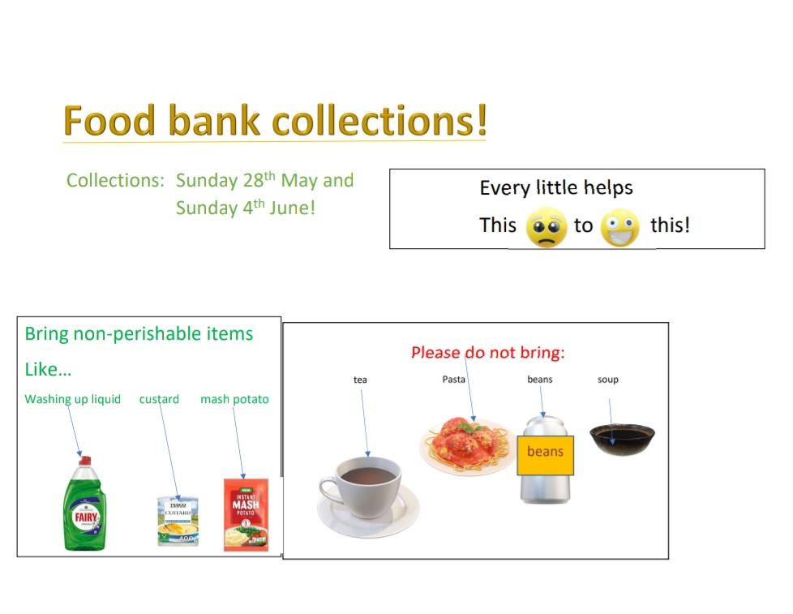

Slide 33


Slide 34
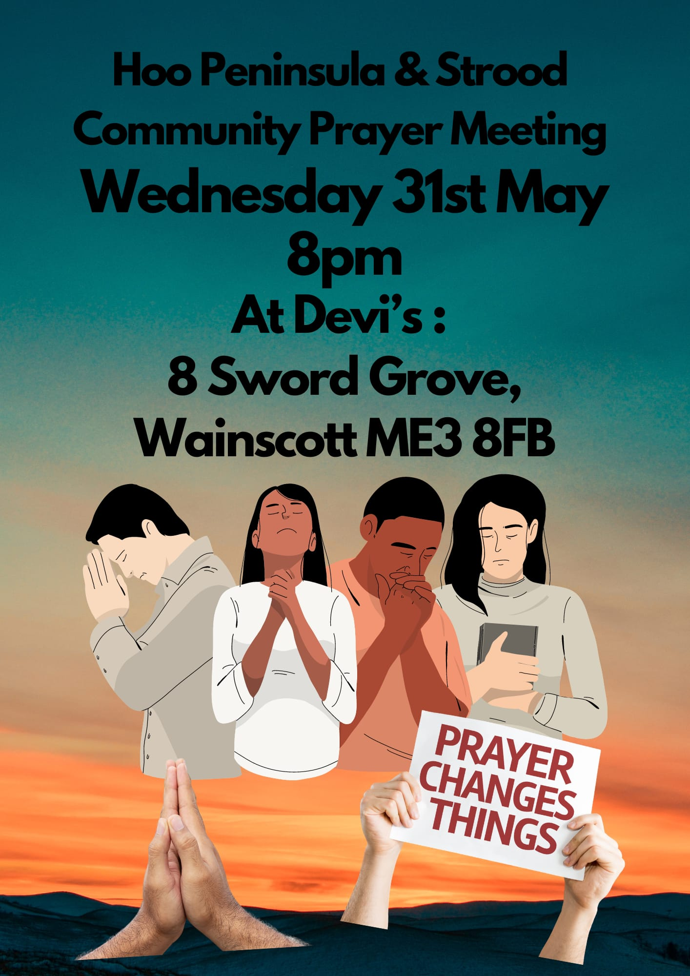

Slide 35


Slide 36


